Slide 1



Transportation Solutions Symposium

Slide 2
Welcome Washington County
Charlie Cofta

Slide 3
Welcome
DWD
Michele Carter

Slide 4
Workforce Data

Slide 5
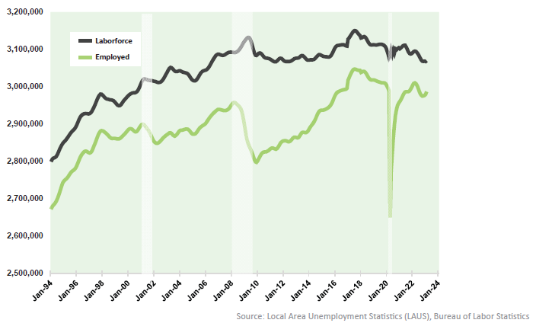
Workforce Participation
Source: DWD Washington County Profile and Local Area Unemployment Statistics (LAUS)
Notes:
Labor force participation is declining across the region, driven largely by demographic shifts.
Implications for workforce availability are significant.

Slide 6
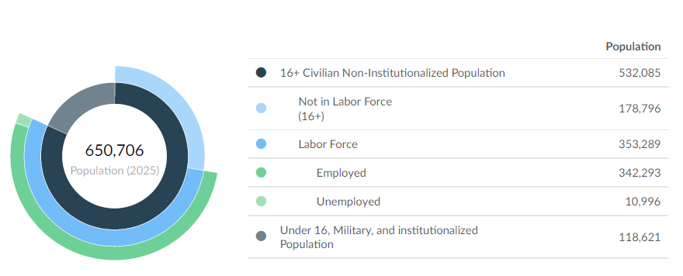
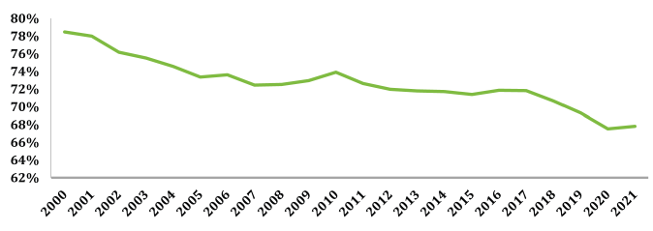
Workforce Participation
Source: Lightcast
Source: DWD Washington County Profile
Notes:
Labor force participation is declining across the region, driven largely by demographic shifts.
Implications for workforce availability are significant.

Slide 7
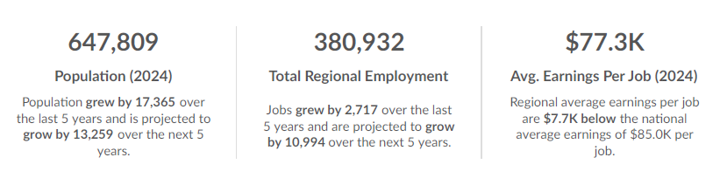
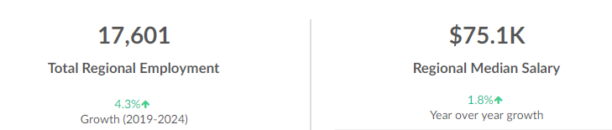
Workforce Participation
WOW Region
Germantown
Source: Lightcast
Notes:
Labor force participation is declining across the region, driven largely by demographic shifts.
Implications for workforce availability are significant.

Slide 8
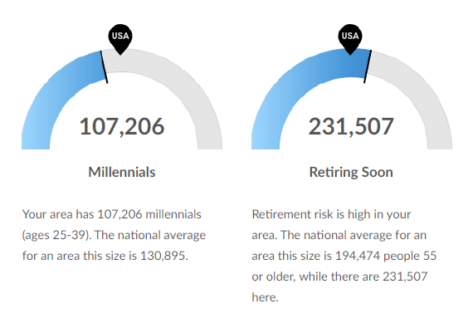
Workforce Participation
Source: Lightcast
Notes:
Labor force participation is declining across the region, driven largely by demographic shifts.
Implications for workforce availability are significant.

Slide 9
Barriers to Participation
Housing
Transportation
Childcare
Broadband
Source: DWD Washington County Profile
Notes:
Broadband: 10.4% of Washington County residents do not have internet access, almost 3:1 are households earning less than $20K/year
Housing: A lot of great work has been said by other groups, but on average, Washington County residents – 41% of renters are paying more than 30% of their income on housing and 19% of homeowners are paying more than 30% of their income on their mortgages and these are in line with state-wide averages

Slide 10
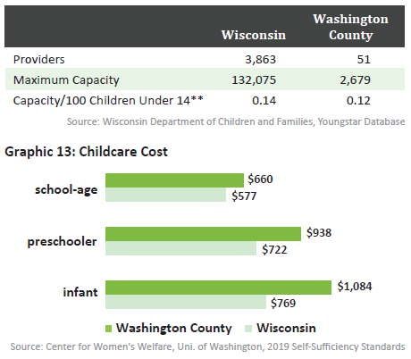
Childcare Capacity & Cost
Source: DWD Washington County Profile
Notes:
For context, cost for infant care is about 30% of monthly median
income of a truck driver in the county.
For context, tuition and books at MPTC is a little over $700/month for a 9 month course of study.
QUEST highlight
Parents need to decide if they want childcare close to home or close to work – may depend on length of commute times

Slide 11
Transportation
 | WI | Washington Co | Ozaukee Co | Waukesha Co
% Residents to other Counties | 28% | 47.2% | 45.6% | 33.7%
% Workers from other Counties | 24.3% | 46.8% | 45.1% | 32.4%
Mean Commute Residents | 22 Min. | 25 Min. | 23 Min. | 24 Min.
Mean Commute Workers | 22 Min. | 22 Min. | 23 Min. | 24 Min.
Source: DWD Washington County Profile
Notes:
On average, around 90% are commuting via car, truck, or van and 80-85% are commuting alone

Slide 12
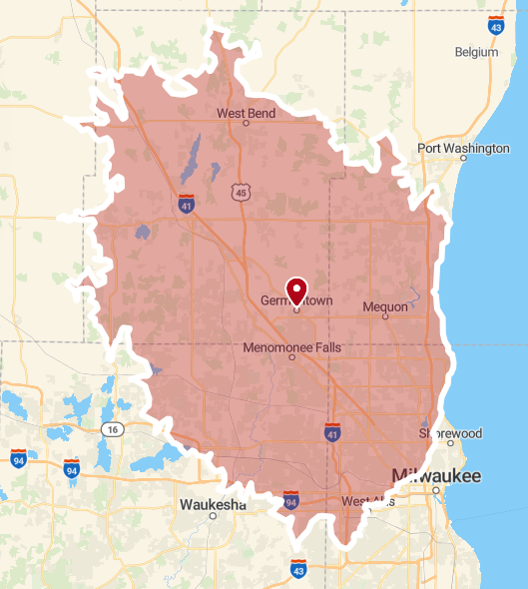
Transportation
Source: Smappen
Notes:
On average, around 90% are commuting via car, truck, or van and 80-85% are commuting alone
25 Minute Map

Slide 13
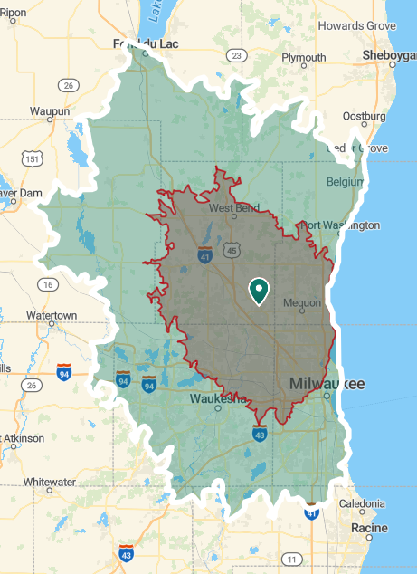
Transportation
Source: Smappen
Notes:
On average, around 90% are commuting via car, truck, or van and 80-85% are commuting alone
45 Minute Map

Slide 14
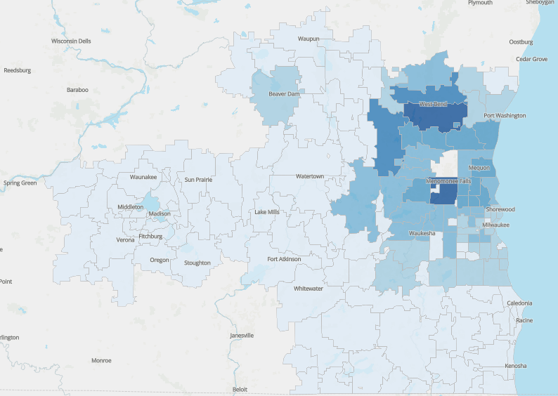
Where people are coming from
Source: Lightcast
Notes:
760 from Menomonee Falls
636 from S West Bend
53 from Bever Dam
Around 100 from each of the bottom row of light blue (S Waukesha/S MKE area)
6 – 10 from each zip along the state line
Zips west of Madison make up about 20 people who commute 1 hour 45 minutes each way

Slide 15
Transportation
Source: Smappen
Notes:
On average, around 90% are commuting via car, truck, or van and 80-85% are commuting alone
45 Minute Map

Slide 16
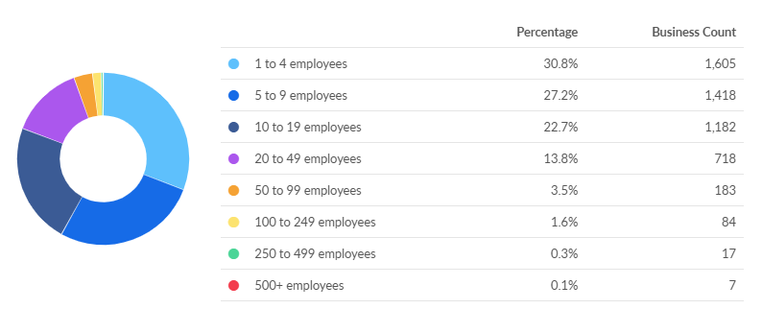
Business Size
Source: Lightcast
Notes:
Collaboration is key

Slide 17
Solutions

Slide 18


A Service Of
Dave Steele
Executive Director

Slide 19
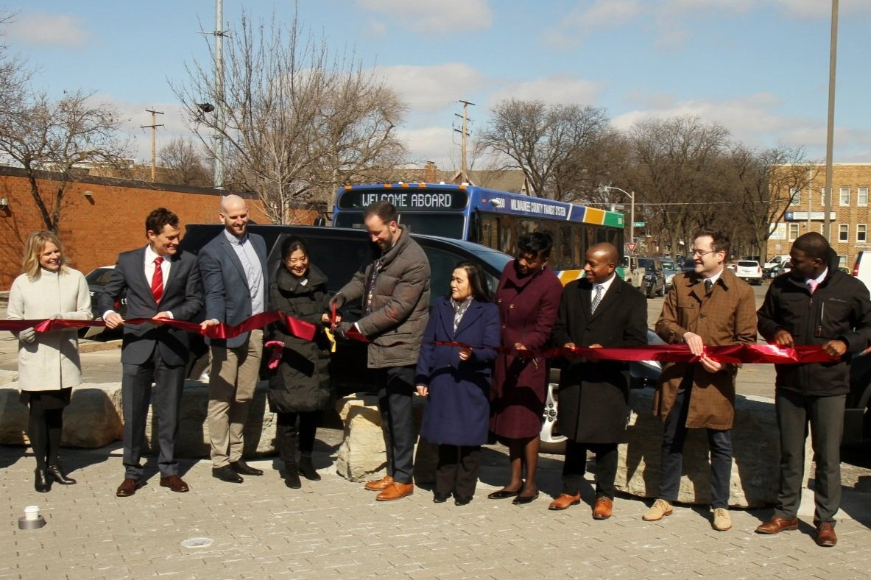
About MobiliSE
501c3 Nonprofit Organization
Board made up of regional civic and business leaders
Convene regional leaders and advocate for transportation improvements
Launched and oversees FlexRide Milwaukee

Slide 20
The Story of FlexRide
2015
2020
2021
March 2022
June
2022
April
2023
Regional Transit
Leadership
Council
Formed
National Science Foundation Planning Grant Secured
NSF $1M implementation Grant secured
Pilot Launched
$4.2 million State grant awarded for Expansion
Launch ”FlexRide 2.0”

Slide 21
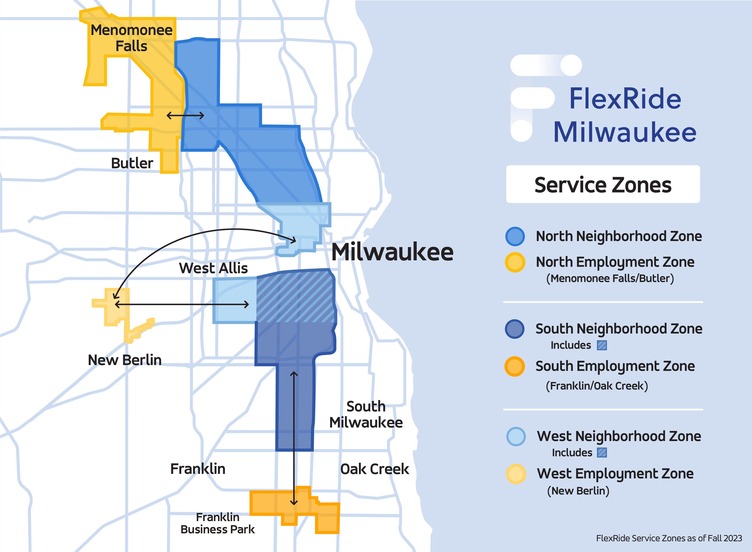
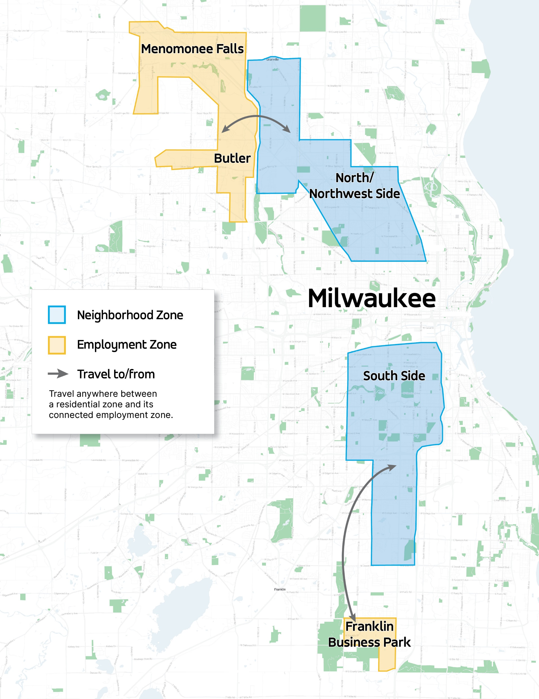

Where Does FlexRide
Go?

Slide 22
2022
2023
2024
2025

Slide 23
Rides by Employment Location 2024
46,724
1,846
6,999
1,842
1,956
Total Rides 59,367

Slide 24
27% of all rides go to/from FedEx

Slide 25
2025 Funding Sources
$1,150,000
$500,000
$125,000
$320,000
$25,000
$108,000
TOTAL $2,234,000

Slide 26
Long Term Revenue – 2026 and beyond
State and Federal sources – Workforce Development, Transportation
Federal Earmarks
Milwaukee County – potential collaboration on FlexRide with MCTS
Private Charitable Funding
Business Input – 10% of operating costs

Slide 27

Orlando Owens

Slide 28
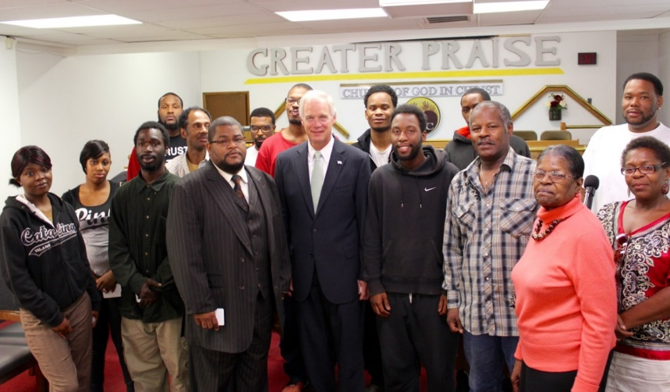
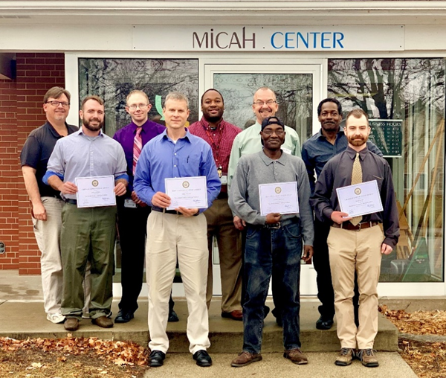
Changing Lives One Person at a Time

Slide 29
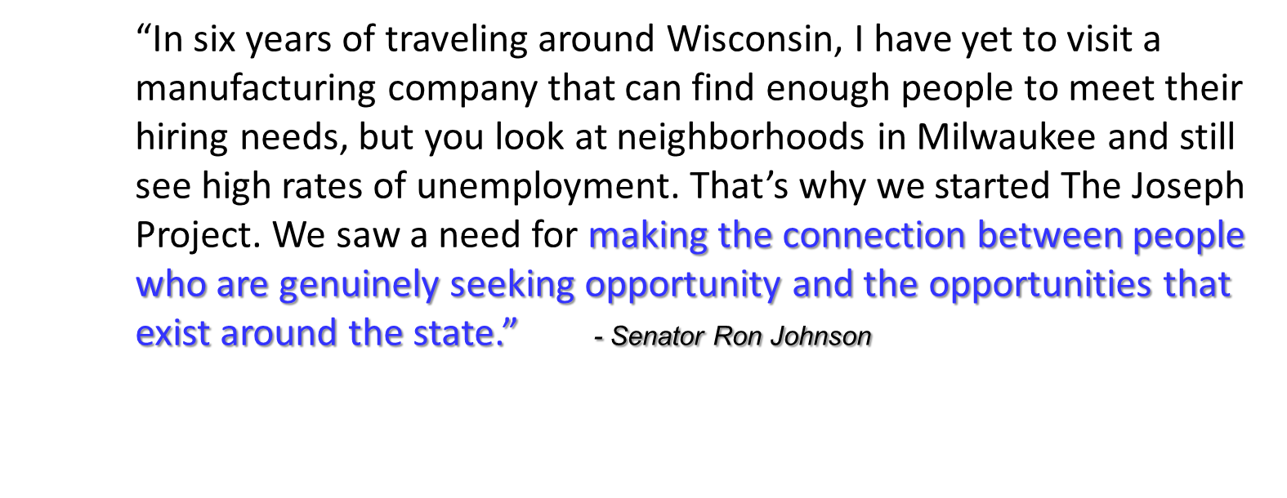
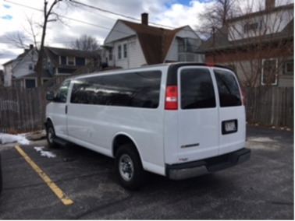
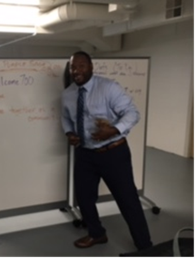
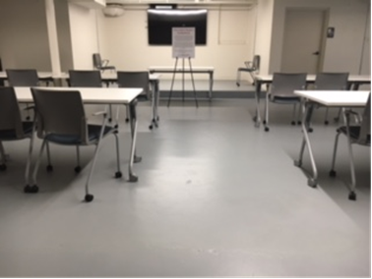
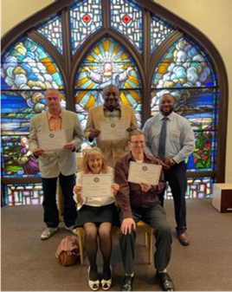
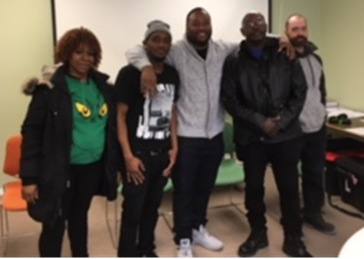
Value Proposition

Slide 30
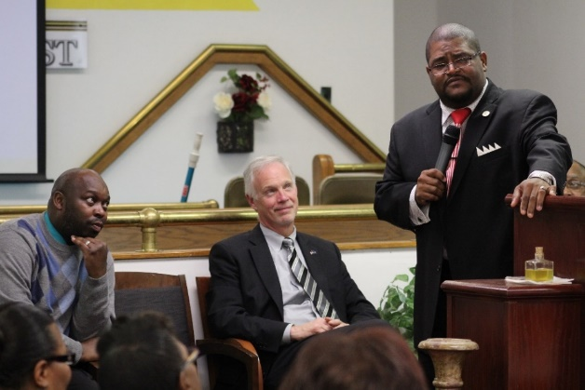
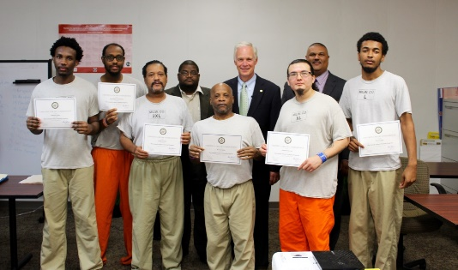
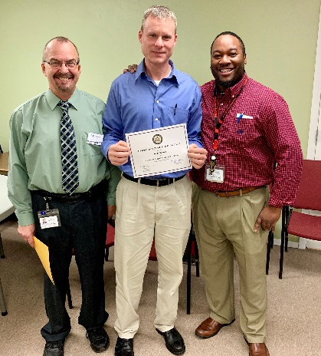

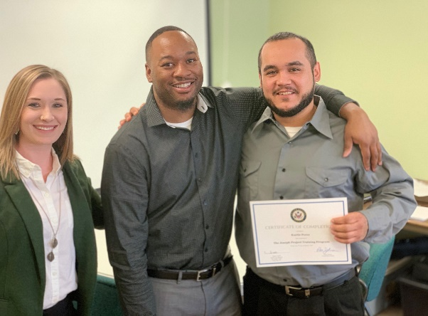
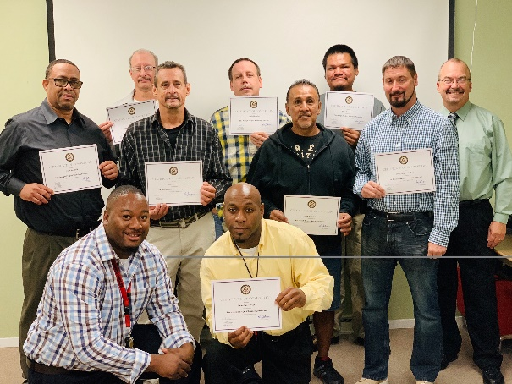
The Joseph Project Mission Statement
“Connect those genuinely seeking opportunity with opportunities that already exist.”

Slide 31

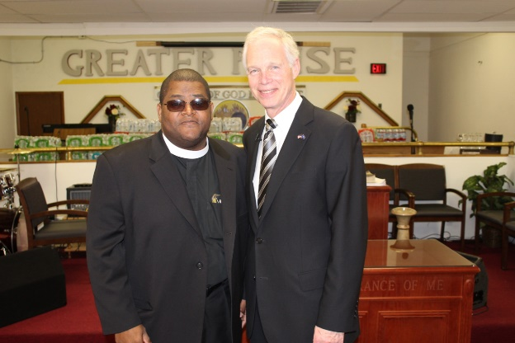
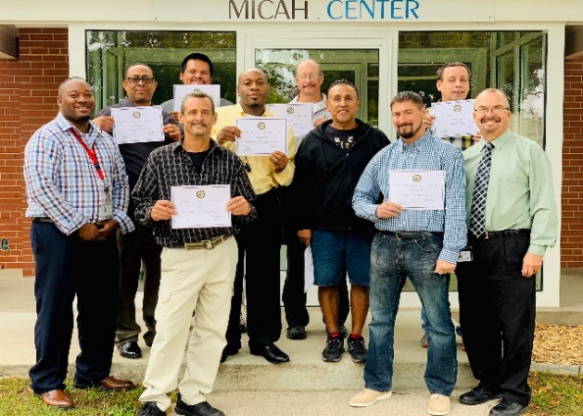
Who We Are…
A partnership between the faith, human service and business communities
We remove the obstacles to good paying jobs
Volunteers
We accept NO federal or state tax dollars

Slide 32
The Joseph Project…
Self contained, comprehensive path to employment
Complete end to end in one week with Mentoring and Case Management aftercare
Standardized process for employers and candidates
Market tested critical path that works
Over nine years experience in training essential employability skills
Scalable model which has been employed across the state

Slide 33
Our Impact…
Since 2015, Joseph Project has conducted over 170 workshops providing essential skills training for nearly 1,100 people in Wisconsin
Joseph Project graduates who successfully complete the training are offered an opportunity to interview for a direct-hire career-potential manufacturing job with full benefits. Over 70% are hired.
The cost of the essential skills workshop is less than $225 per person. [No taxpayer $$$]
Since 2015 the Joseph Project has provided over $135 Million dollars of positive economic impact to the State of Wisconsin
  Each person that earns their independence and leaves government assistance roles saves taxpayers $50,000 per year
  Joseph Project alumni have earned over $53 Million in wages
  The average starting wage for our graduates is $18 per hour

Slide 34
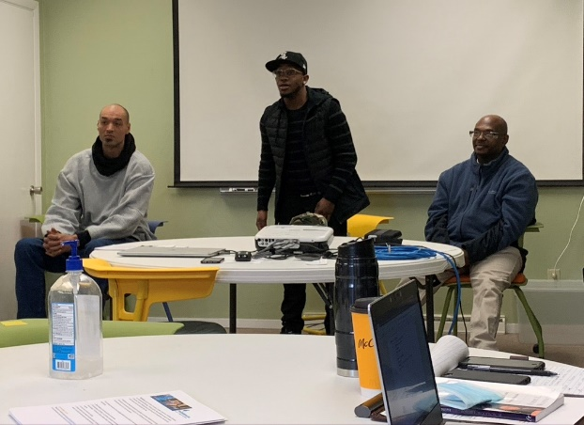
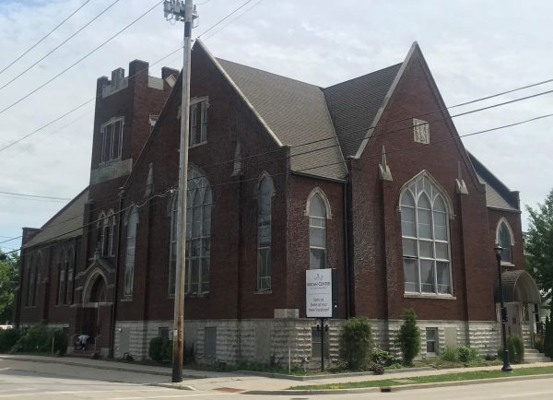
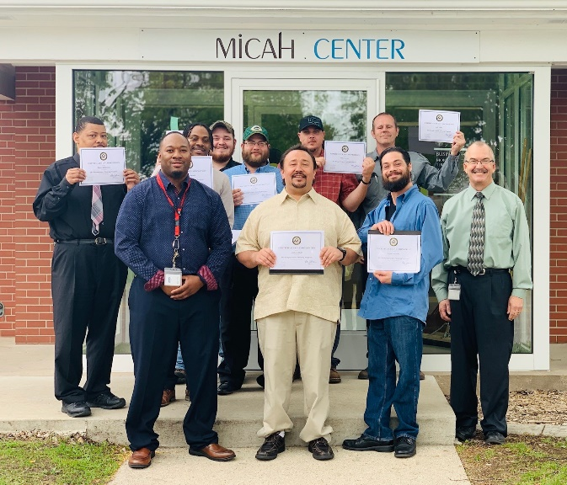

What we do…
Find, vet potential applicants
Essential skills workshop
Interviews
Transportation
Mentorship
Advocacy
the
JOSEPH
P RO J ECT

Slide 35
How We Do It…
We Create Sufficient Key Touches to Influence Candidates
Recruiting, Interviews & Intake
Introduction & Orientation
Essential Skills Workshop focused on three areas:
  Interview performance
  Dealing with change/success
  Joining a new team and keeping the job
Mock Interviews to prepare
Manufacturing Employer Interviews
After Care - Mentorship, Case Management
Building Stronger Communities

Slide 36
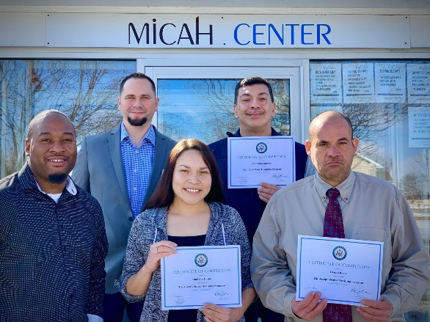
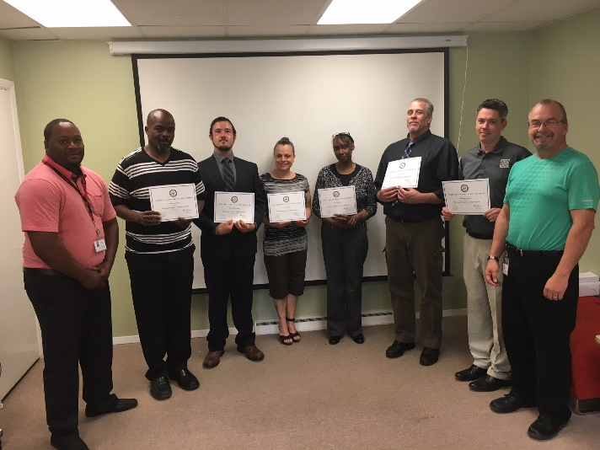
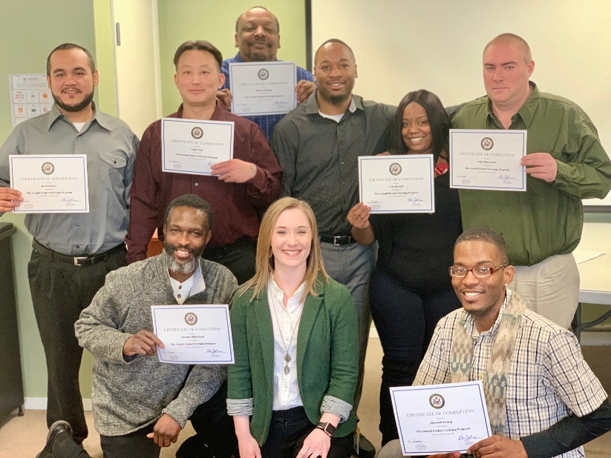
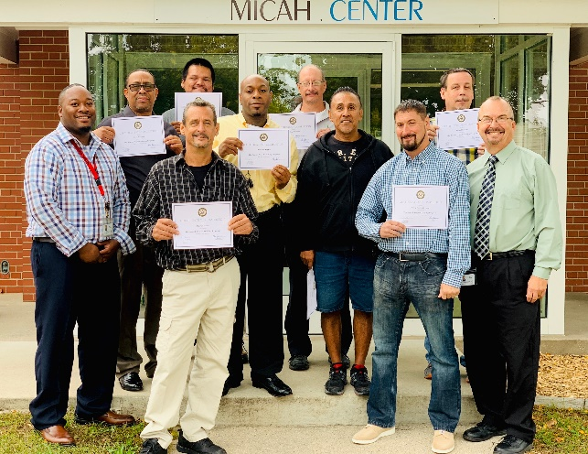
We Build Communities…
Candidates
Business Partners
Volunteers
Staff
Community
Faith Community
Human Services
Law Enforcement

Slide 37
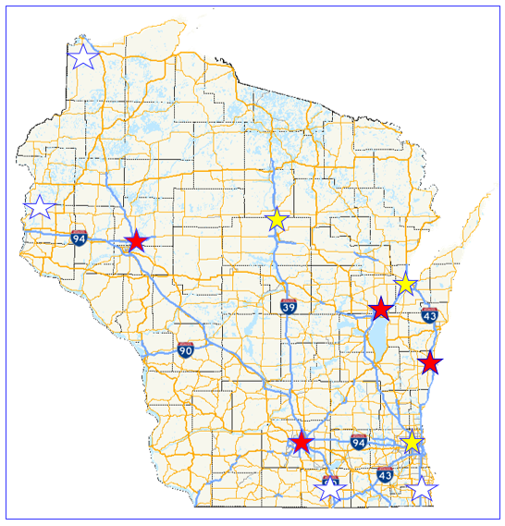
Where We Are/Were/Going…
Milwaukee
  Greater Praise COGIC
  Community Reintegration Center (HOC)
Appleton
  Family First Ministries
Sheboygan
  POSC & Ebenezer UCC
Madison
  Capital City Sanctuary
Wausau
  The Cross Church
Green Bay
  Gateway Collective
Chippewa Falls
  Northern Wisconsin Center

Slide 38
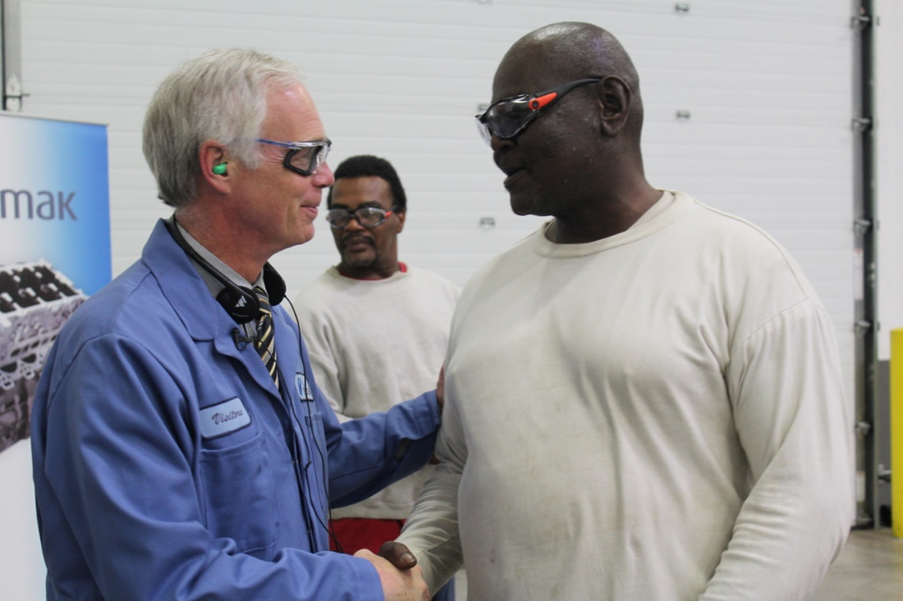
Community Impacts…
Celebrating the dignity of work and living a purposeful life
Graduates setting positive examples for young people
Rebuilding families
Escaping dependency
Combatting recidivism
Keeping the door open for others to follow
People paying their bills, strengthening the community

Slide 39

Valerie Hoff

Slide 40

Notes:
CLICK TO TRANSITION
Commute with Enterprise has been around for 30 years and was born to give employers and commuters flexibility and the support they need to transform the daily commute into a positive part of
their day. As the country's largest vanpool provider, we're always working to make the ride to and from work easier, more affordable and better for the planet.
NEXT SLIDE

Slide 41
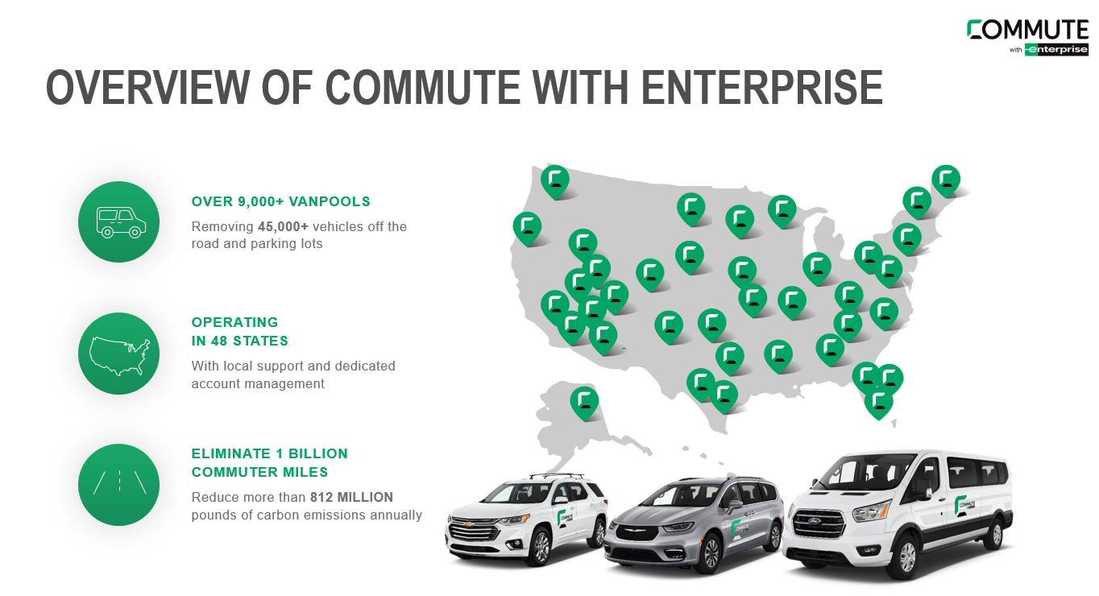

Slide 42

Commuting Impact by the Numbers
55%
19%
$0.56
Americans concerned about maintaining cost of living¹
Amount of employee salary spent on commute anually²
Cost per mile to own/operate a vehicle in 2023³
55
45%
13.1
Minutes of the day spent commuting ⁴.
Americans without access to public trans⁵.
Average age of vehicle in years ⁶.
1. US Department of Transportation 2022 (Transportation definition includes personal vehicles). Gallup Economy and Personal Finance Poll 2024, 2. US Department of Transportation 2022 (Transportation definition includes personal vehicles). Gallup Economy and Personal Finance Poll 2024.
3. https://www.census.gov/newsroom/press-releases/2021/one-way-travel-time-to-work-rises.html 4. https://www.apta.com/news-publications/public-transportation-facts/ , 5. Source: Statista Consumer Insights 2023, S&P Global Mobility, IPSOS Global Business Travel Survey.

Slide 43
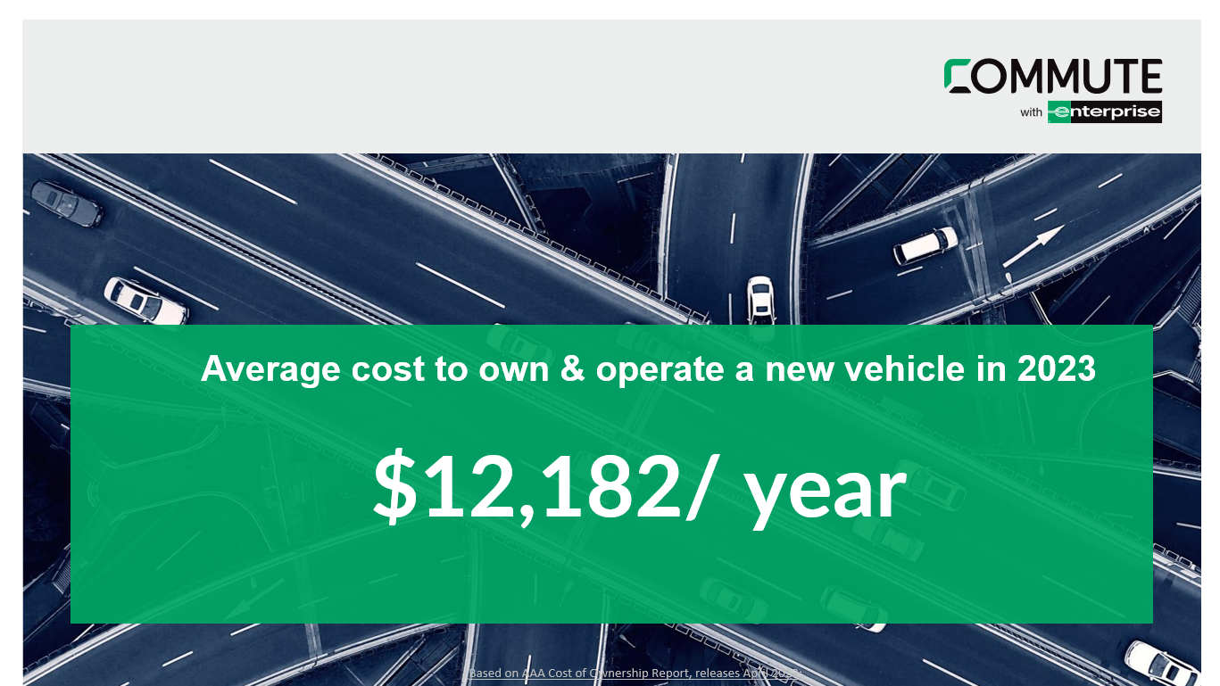
Did You Know?

Slide 44

Employer Impact
Employers are also experiencing the impact of the evolving commuter landscape.
Average cost to own
each parking spot¹
Top reason employees
prefer remote work²
Have quit because
of their commute³
Cost to recruit
new talent⁴
Cost of time and productivity lost due to traffic/yr⁵
$28K
#1
23%
3-4X
$70B
1. CNN, “The little-known rule shapes parking in America. Cities are reversing it.” 2. Why the Commute? (gallup.com). 3. SHRM, “The Real Cost of Recruitment, 4.https://www.sba.gov/blog/how-much-does-employee-cost-you. 5. Global Traffic Scorecard INRIX 2024. Statista Consumer Insights 2023.

Slide 45
Solutions

Slide 46


What is Vanpooling?
1
2
3
4
5
Connect employees to commute together
Assign a recent-model SUV
or Van
Establish a common meet up spot.
Share a commute and driving responsibility
Enjoy the
perks!
INCLUDED:
Vehicle Liability Insurance
Physical Damage Protection
Driver qualifications/approvals
Vehicle Maintenance
24/7 roadside assistance
Local program support
Monthly Rider impact reports
Advanced mobile app

Slide 47
Why Commuters Choose Us
Easy Enrollment
Browse existing vanpools online or submit interest in starting your own!
Flexibility
No long-term commitments.
Savings
The average 5-day participant saved $10,000 in 2024¹.
Peace of Mind
Vehicle liability insurance, physical damage protection, 24/7 roadside assistance, emergency ride home.
Reliable Vehicles
Recent model SUV or van with maintenance & fuels costs included.
Shared Driving Responsibility
Approved participants share driving responsibility
Digital & Human Support
Digital onboarding, mobile scheduling & drivers' tools, online impact dashboards + local support from our team of experts.
1.Estimates based on 2024 Commute with Enterprise reporting, an average 5-day/ week commute and 2024 AAA costs associated with operating a vehicle including fuel, maintenance, and depreciation. Show me the Math.

Slide 48
Implementation & Support

Slide 49
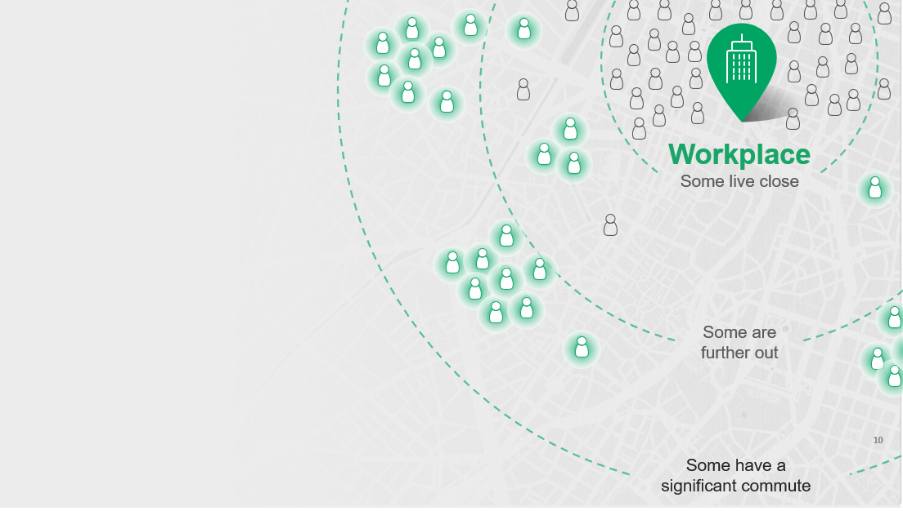
Identify Candidates
Map your employees based on schedule and proximity to the worksite.
Identify groups that live close together.
We’ll form routes to match their commute and work with your company to develop awareness efforts and get employees on board!

Slide 50

 | Monthly Cost | Cost/Passenger | Cost Per Trip/Person
7 PASSENGER MINIVAN | $1,350.00 | $270 | $6.42
7 PASSENGER SUV | $1,450.00 | $290 | $6.90
15 PASSENGER VAN | $1,750.00 | $175 | $4.17
Shuttle – 15 PASSENGER | $1,700.00 | $170 | $X
Calculations are based on 2,000 miles free per month.
$125/month per 500 miles additional

Slide 51

We’re with you every step of the way
Customized Plan
Marketing Tools & Commuter Connection Meetings
New Rider Onboarding
Fleet Management
Transparent Billing/Budgeting
Dedicated Account Management

Slide 52

Why it Works
It’s Needed
It’s Impactful
Changing Commuter landscape
Rising cost of living
Evolving needs & expectations from employees
Saves Money
Reduces Carbon Footprint
Recruitment & Retention Solution
It’s Measurable
It’s Easy to Implement
Online rider impact dashboard
Quarterly updates
Align on a plan forward
Help us promote the program
Watch us take the wheel and drive change

Slide 53




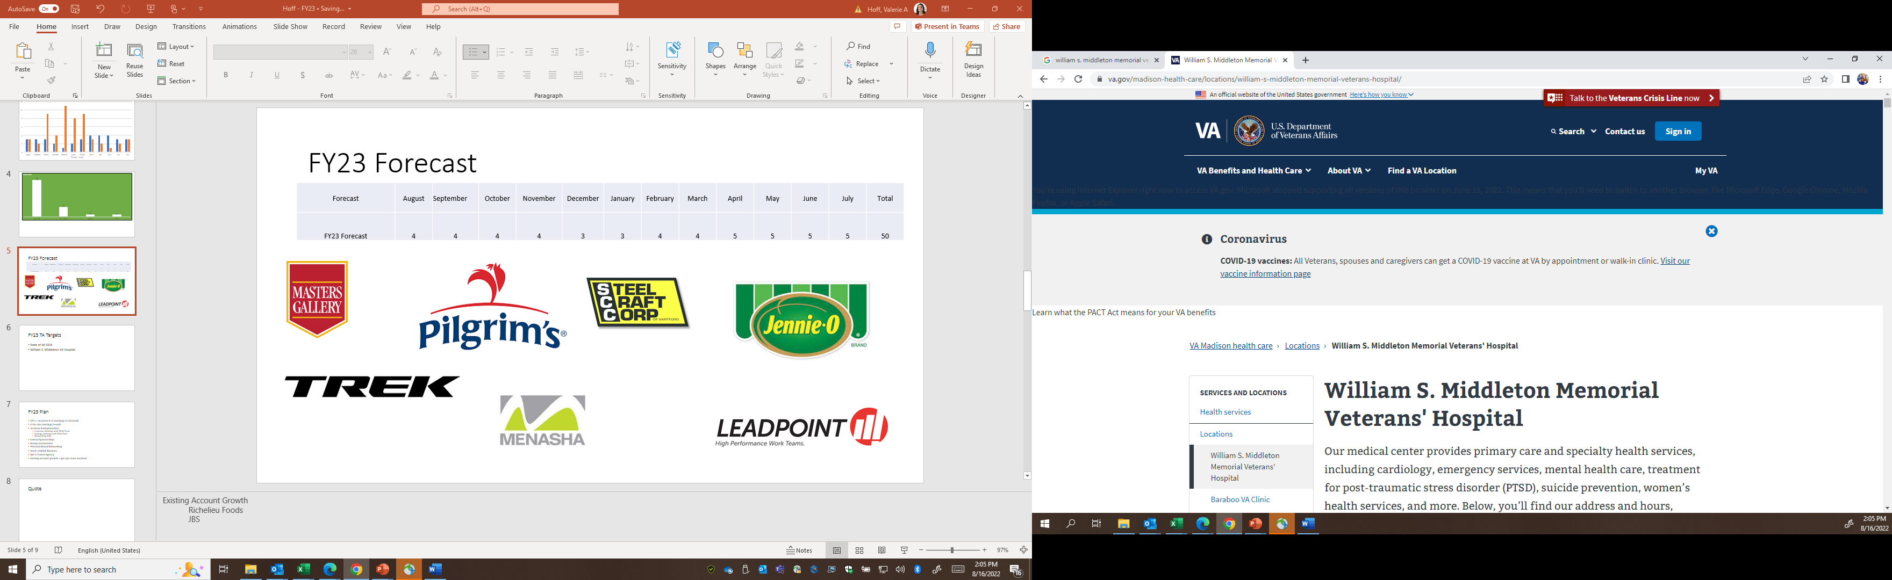




Notes:
Share about each company
As you can see, we work with companies in a variety of ways whether it be for all employees or certain pockets of employees. I know many of you here attended today because you were looking for ways to attract and retain talent so if you are a company that has a certain group of individuals are recruiting territories you are looking to pull from – or are looking for a new employee benefit that tackles one of the top 3 barriers to employement, - or have any needs to move small groups of employees to jobsites for work, training, apprentiships, etc – I strongly encourage you to reach out so we can discuss.

Slide 54
Q&A

Slide 55

Valerie Lefler

Slide 56


Slide 57

OUR MISSION
Mobility solutions for the health and wellbeing
of every person in every community.

Slide 58


THE PROBLEM
The fragmented labyrinth of resources, policies, and programs for transportation is not working for those who rely on it the most.

Slide 59
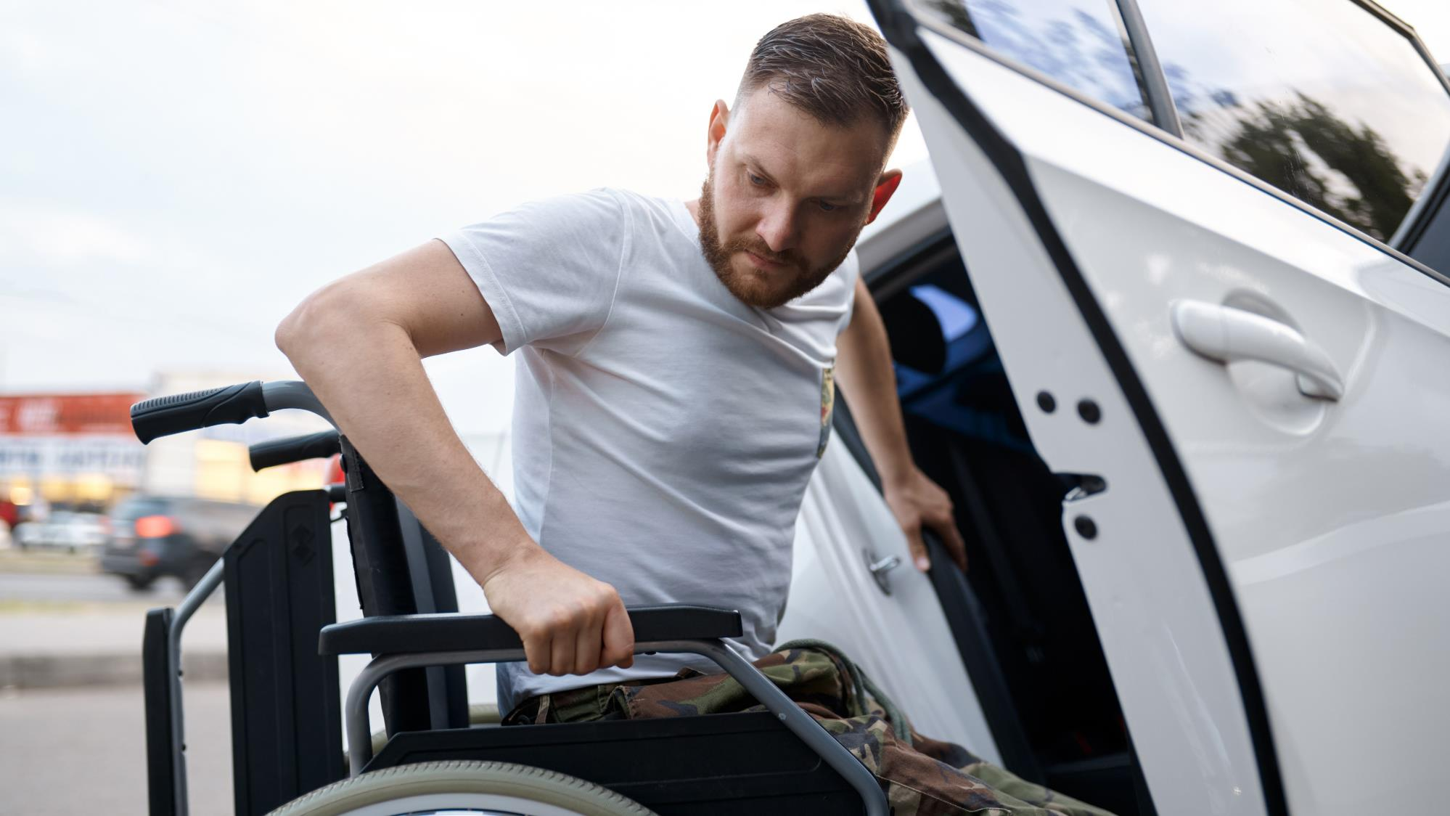








Transportation Assistance Hubs
Enable Mobility for all Social Determinants of Health
Transportation
Assistance Hub
Social Services Providers
Wellness & Medical Appointments
Groceries
Employment

Slide 60
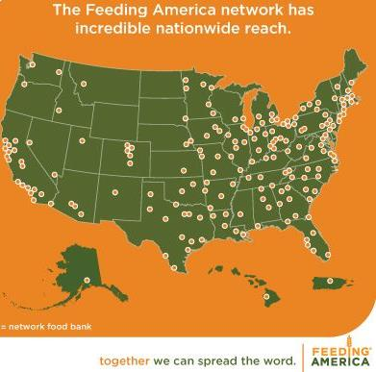
Transportation Assistance Hubs
Create a safety net program for individuals experiencing mobility insecurity.
Offer comprehensive resources that are complimentary to healthcare, social services, education, and the private sector.
Enable a consistent operational framework of technology, data, learnings, and resources that can be deployed nationally.

Slide 61




Feonix Solution for Mobility Insecurity
Transportation Assistance Hub
Staffing
Community Development Manager
Mobility Navigator
Fundraiser
Technology
Community Operations Support Center
MaaS Technology
Mobility Wallet
Community Support
Mobility Leadership Circle
Transportation Directory
Transportation Subsidy Library
Capacity
Local Transportation Providers
- Public, Private, & Public Transit
Volunteer Drivers

Slide 62


WISCONSIN WORKFORCE
INNOVATION GRANT
Funded by: Wisconsin Department of Workforce Development
Grant Recipients: Waupaca County Economic Development Corporation
  Make the Ride Happen
  Feonix – Mobility Rising
Focus on Employment Rides as Top Priority
Additional Capacity – Health, Wellness, Caregiver Support
Community Development Manager Locally to Support Community Engagement & Partnerships
Feonix Deployed 5 Vehicles and 8 Drivers – Offering Service 24/7 – Ensuring Rides Available for Night & Weekend Shifts, Volunteer Drivers, & Partnering with Taxi Services

Slide 63
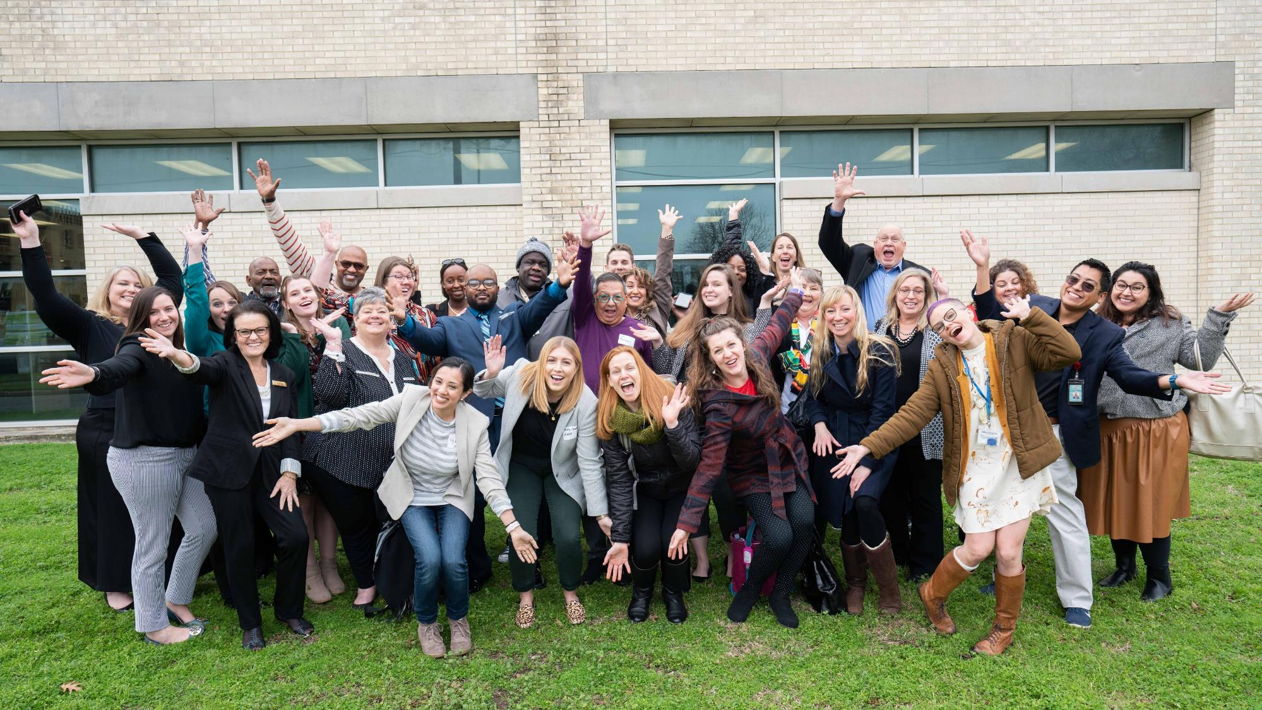








Mobility Leadership Circle
Healthcare
Food
Mobility Leadership Circle
Elected Officials
Education
Transportation
Housing/ Utilities
Social & Community
Employment

Slide 64
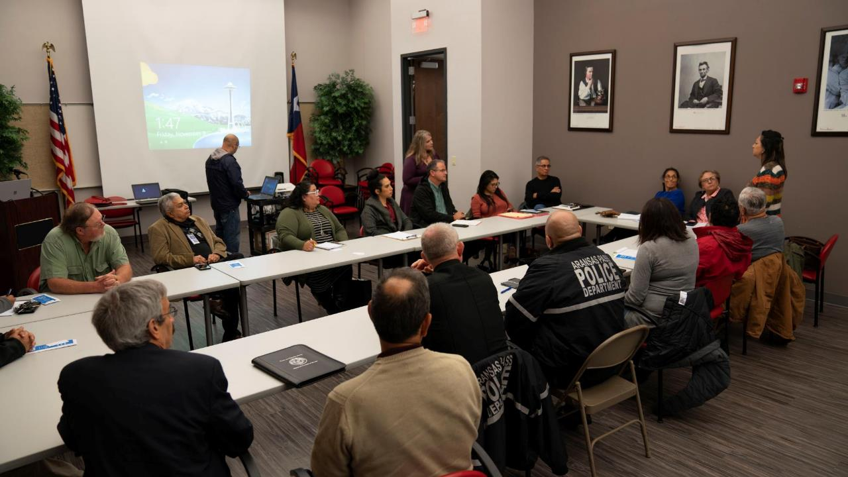




Mobility Leadership Circle
Purpose:
leverage, connect, and optimize all available resources to address SDOH.
Action teams are established based upon community priorities in a phased approach and can be customized based upon high priority or high need populations.
Entire group meets quarterly as community leadership circle – reporting updates & program initiatives.

Slide 65

PROJECT PARTNERS
& COLLABORATORS
New London Chamber of Commerce
Waupaca Area Chamber of Commerce
Clintonville Area Chamber of Commerce
University of Wisconsin-Madison- Extension Waupaca County
East Central Wisconsin Regional Planning Commission
City of Waupaca
City of New London
City of Weyauwega
City of Clintonville
City of Manawa
Village of Fremont
Waupaca County
Tyson Foods
Waupaca Foundry
ThedaCare Health Services
ThedaCare Community Health Action Team
Walker Forge
Kolbe & Kolbe Millwork Co, Inc.
The New North, Inc.
And Many others!

Slide 66

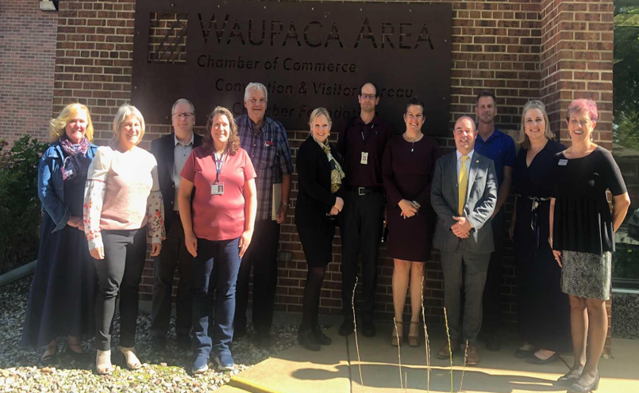
MOBILITY
COORDINATION
One call / one click - mobility as a service ride booking technology – connect via advanced APIs or via simple online interface
  Call Center Available:
  Monday – Sunday 5 AM - Midnight
Coordination and mobility management with existing transportation providers

Slide 67
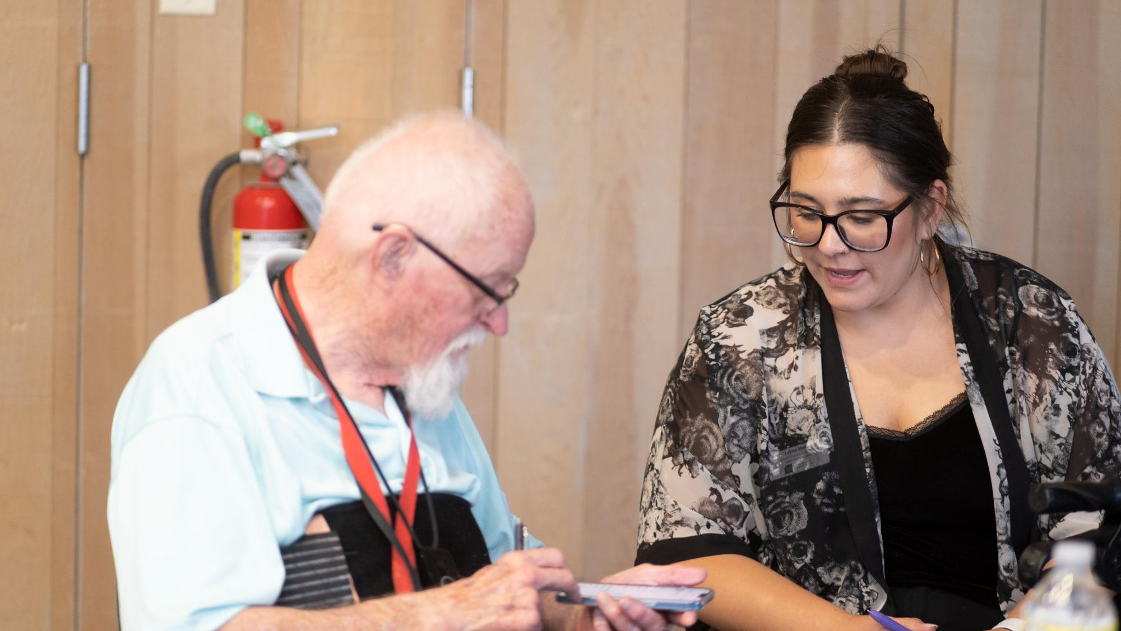
Mobility Navigator
Mobility Navigator
Free & Discount Rides
Vehicle Procurement Assistance
Drivers License Assistance
Short Term Vehicle Assistance
Travel Planning
Budgeting
Referrals to Social Service Organizations
Individualized Mobility Management
  Enhanced Eligibility
  Criteria for Resources
Expertise & Support Navigating Complete Transportation Ecosystem

Slide 68



SUPPORTING ALL
COMMUNITY MEMBERS
Including Individuals/Families in Poverty
Family Size 1 | 250% FPL $2,831.25
2 | $3,814.58
3 | $4.797.93
4 | $5,781.25
5 | $6,764.58
6 | $7.747.93
7 | $8,731.25
8 | $9,714.58
9 | $10,697.93
10 | $11,681.25
Subsidized Rates Available:
Household Income 250% of Poverty Level
First 30 Days Free
Rate of $1 Per Trip Leg
Must Have Completed Application – Average
of Last 3 Months Employment

Slide 69

CASE
MANAGEMENT
Experts in Passenger Support with Complex Needs
Screening Passengers for Ride Subsidies & Wrap Around Referrals
Increasing Access to All Social Determinants of Health

Slide 70








CURRENT IMPACT
Major Employers Served
  Waupaca Foundry
  ThedaCare New London and Waupaca
  Tyson Foods
  Kolbe & Kolbe
  Creative Converting
  Kwik Trip
  Manufacturer’s Pallet Disposal
  Bethany Homes
Rides Available:
  24 hours/day
  7 Days a week
Accepting Payments via Call Center, Web, & App

Slide 71






Mobility as a Service
Public Transport
Uber
Specialty Transport
Volunteer
Drivers
Taxi Company

Slide 72
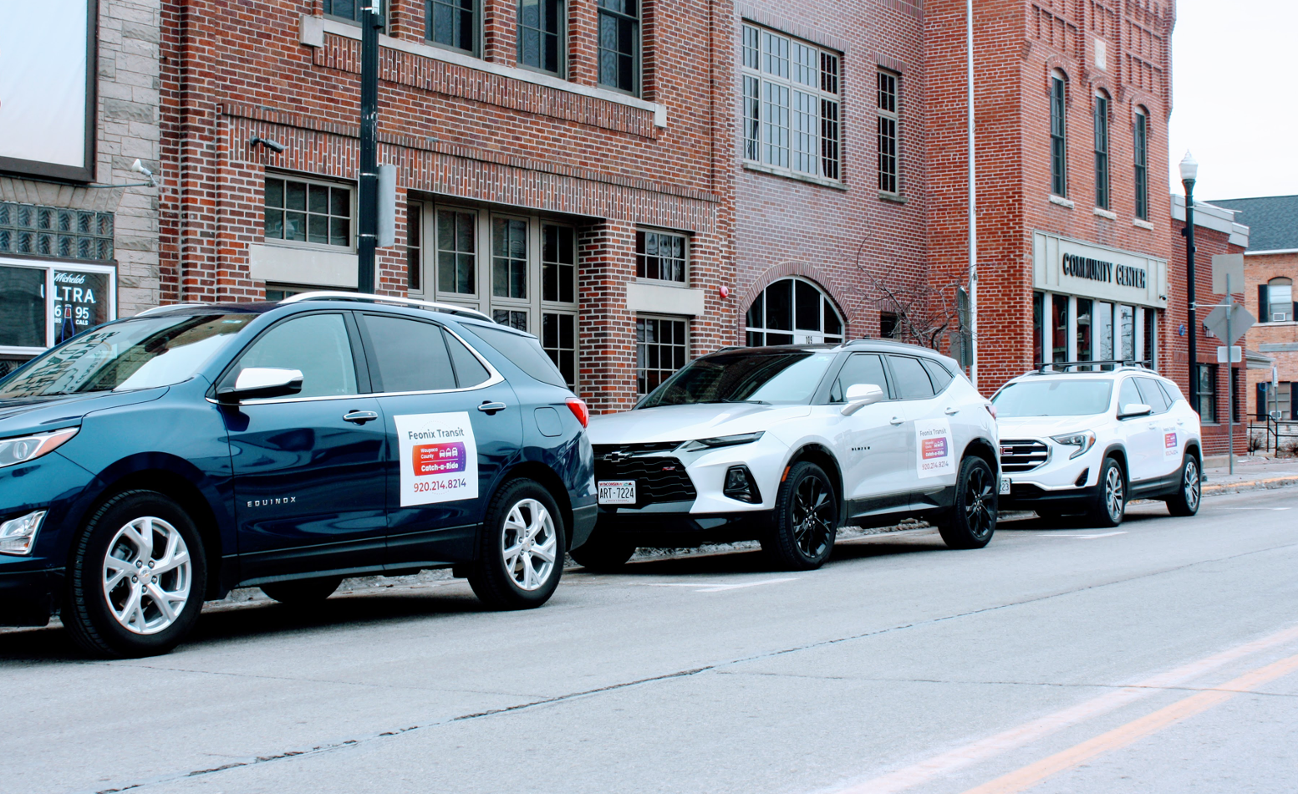
MOBILITY
AS A SERVICE
(MaaS)
Waupaca Taxi
Feonix - Mobility Rising
  Volunteers
  MicroTransit

Slide 73

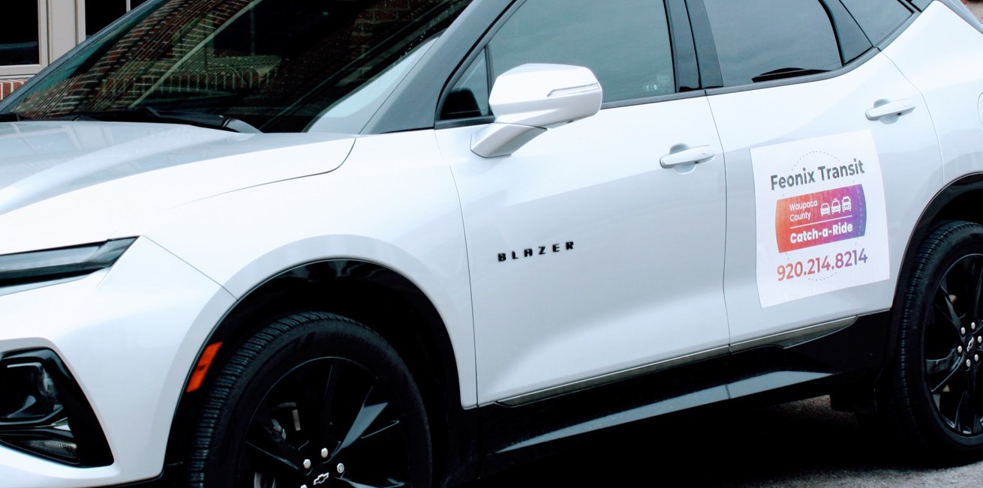
FEONIX MICROTRANSIT
Certified Non-Emergency Medical Transportation Drivers
Ambulatory & Wheelchair Accessible Vehicle

Slide 74




Catch a Ride MaaS Technology

Slide 75


https://waupacacar.org/

Slide 76


Person Centered Regular Testing for Accessibility & User Experience Optimization

Slide 77


Slide 78



INAUGURAL TRIP
12.15.22 - ThedaCare New London ER Dept. Team Member

Slide 79


April

Slide 80


Slide 81


Slide 82


Slide 83
MORE INFORMATION?
QUESTIONS?
vlefler@feonix.org

