Slide 1
Washington County Transit
Transit Manager: Charles Cofta

Slide 2
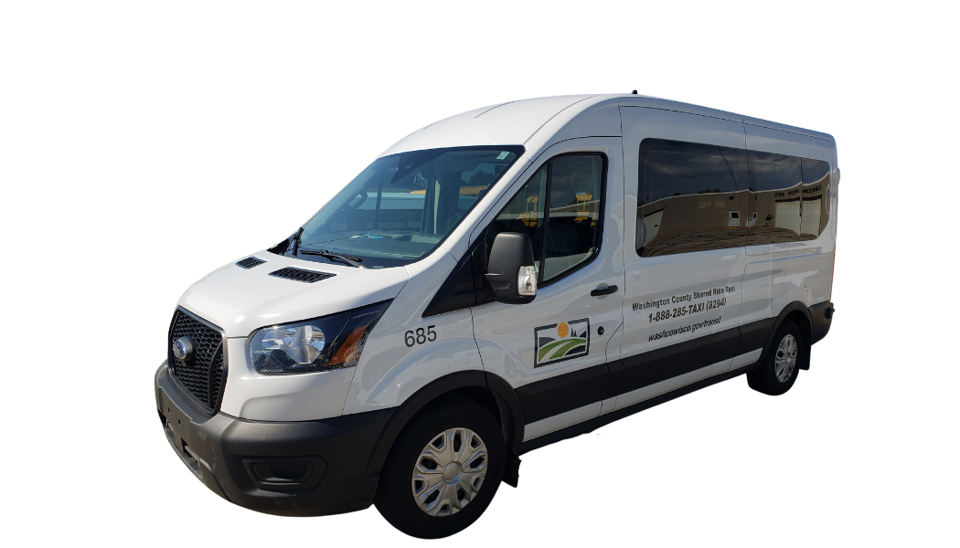
Washington County Transit Service
Shared Ride Taxi (SRT):
Door to Door
Serves all of Washington County, into a portion of Menomonee Falls, and trips going into Ozaukee County
30 vehicles, 27 are wheelchair accessible
Washington County Commuter Express (WCCE):
Commuter Bus Service from Washington County into Milwaukee County
Ended in 2023 due to low ridership

Slide 3
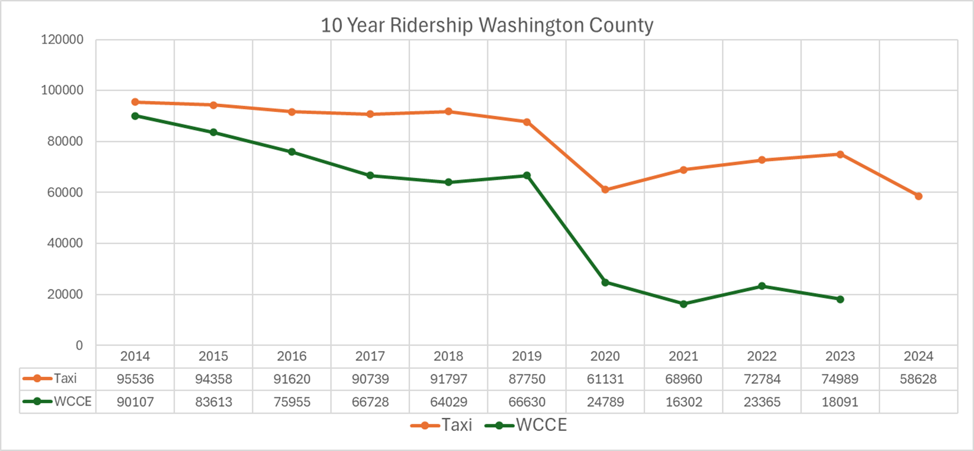
10 Year Ridership History

Slide 4
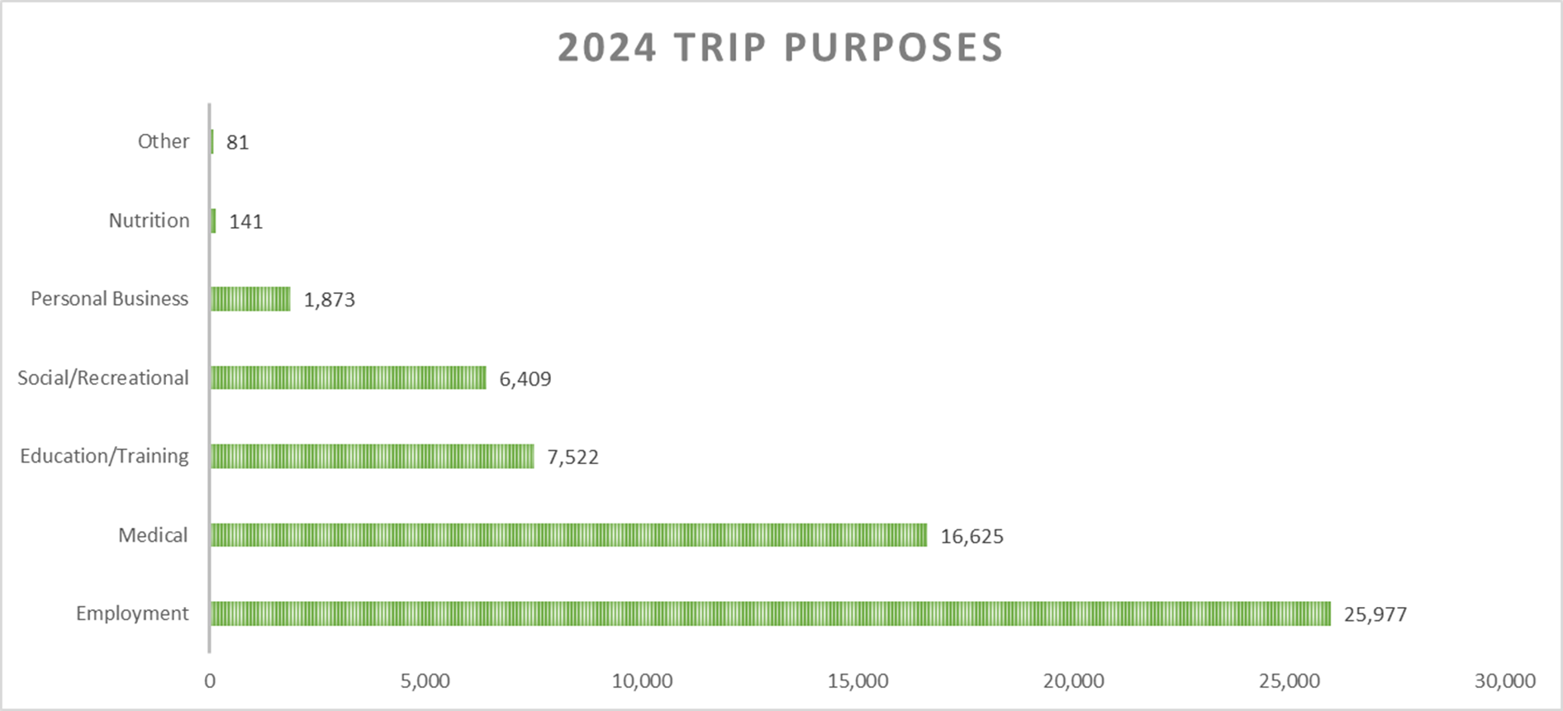
Washington County SRT 2024

Slide 5
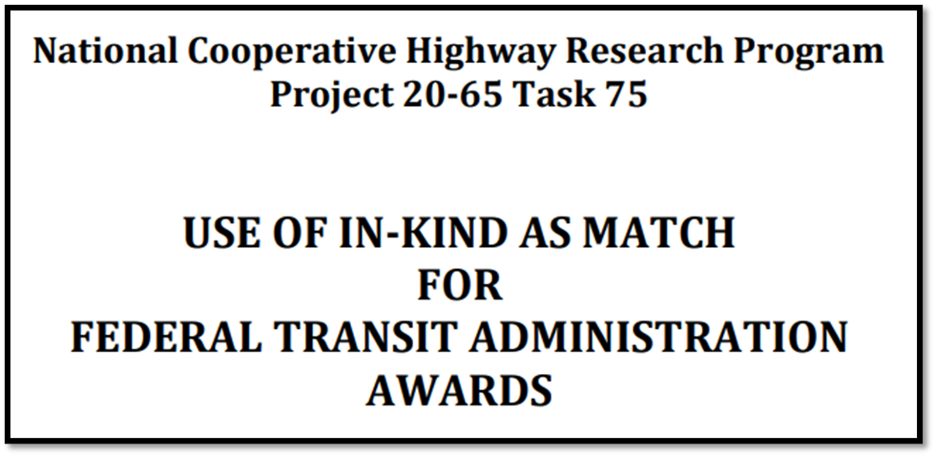
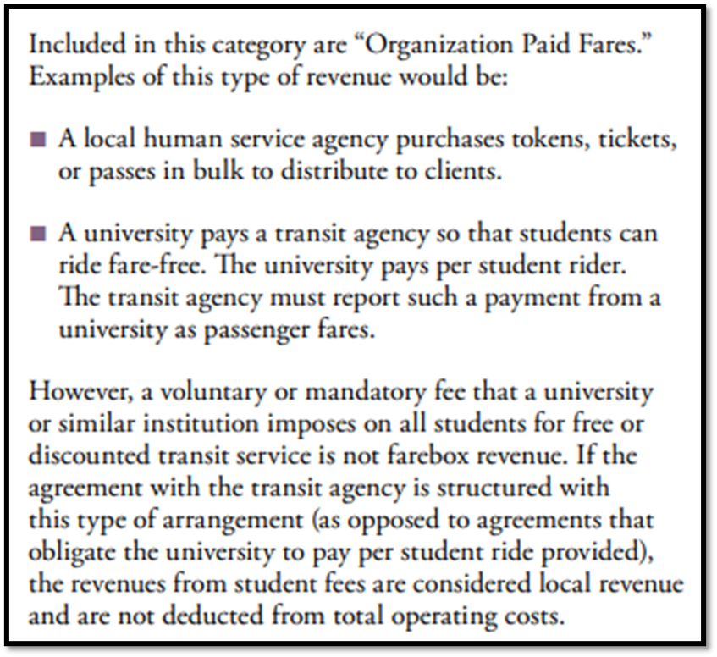
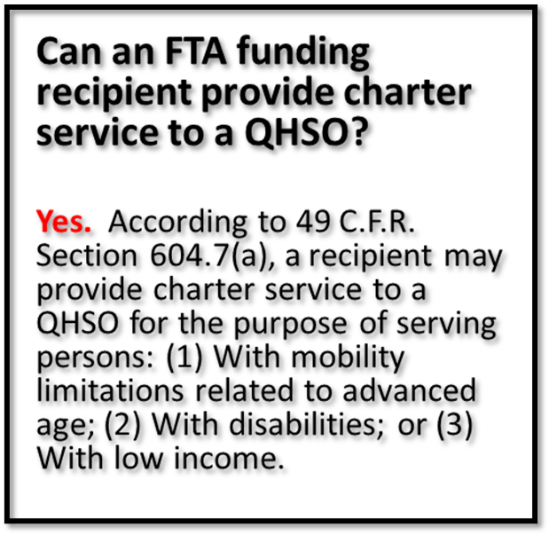
So Many Different Ways to Collaborate!

Slide 6
Thank You!

